Slide 1
CSE495B (Natural Language Processing) Lecture 1 & 2
Overview of the NLP Tasks & Related Problems

Slide 2
Course Logistics
Course Name: Natural Language Processing – (CSE495B)
An undergraduate-level course – supposed to be more conceptual than theory
2 lectures every week (3 hours)
Canvas home page
Tutorials
Project Ideas
Important breakthroughs
Research Ideas
Lectures
Canvas Announcements
Quiz/Mid announcements
Syllabus
Grade updates

Slide 3
Workload and Grading Policy
2 class tests (theory + programming) worth 15%
Theory part: Why does it work?
Practical part: Usage of NN algos, analysis of results, metrics
Best 1 out of 2
Project worth 20% ~ 30%
Pick a project based on your works/idea – must not be from blogs/kaggle/etc.
You can find ideas from canvas posts
Programming part: Implement/use NN algos, analysis of results
Must submit a paper format report
Mid & Final exams worth 50% ~ 60%
Mid & Final will be worth 25% ~ 30% each (total 50% ~ 60%)
They will have 3/4 questions (no choice – must answer all)
Questions will be part theory part practical concepts
Attendance – 5%

Slide 4
Reference materials
Course slides and notebooks will be sourced from previous iterations of this course and relevant slides/materials from me/other researchers/blogs
No fixed textbook
But you can read this free one
Speech and Language Processing (https://web.stanford.edu/~jurafsky/slp3/)
Different books vary in terms of
Set of topics covered
Flavour (e.g., classical statistics, deep learning, probabilistic/Bayesian, theory)
Terminology and notation (beware of this especially)

Slide 5
Course Goals..
Introduction to the foundations of Modern NLP
Focus on developing the ability to
Use NLP based solutions for novel problem solving
Work on NLP projects at jobs/research
Be able to pick the right NLP solution for the problem
Being able to find computational complexities of different NLP methods
Evaluate alternate solutions
Being able to understand the training complexities

Slide 6
What is NLP?
NLP is a branch of Artificial Intelligence (AI) that enables computers to understand, interpret, and generate human language.
It combines linguistics (the study of language) and computer science/AI (machine learning, deep learning) to process text and speech in a way that is meaningful and useful.
However, the scope of modern NLP also includes
Understanding, generating, and interacting with human language across text, speech, and multimodal data
Applications spans almost every domain
Daily life - chatbots, translation to critical sectors
Healthcare, finance, education, national security.
With the rise of deep learning and large language models (LLMs), its scope includes:
Core Language Understanding
Text classification, sentiment/emotion analysis
Named Entity Recognition (NER), Part-of-Speech (POS) tagging
Question answering and information retrieval
Language Generation
Machine translation (e.g., Bangla ↔ English, Google Translate)
Text summarization (extractive and abstractive)
Conversational AI (chatbots, virtual assistants)
Creative generation (stories, essays, code, poetry)

Slide 7
NLP Scopes (Cont.)
Speech & Multimodality
Speech recognition (ASR, e.g., Siri, Google Assistant)
Text-to-speech synthesis
Multimodal NLP: combining text with images, audio, or video (e.g., image captioning, video Q&A)
Advanced Applications
Healthcare: clinical note processing, disease prediction
Finance: fraud detection, document analysis
Legal & policy: contract review, compliance checking
Education: personalized tutors, automatic grading
Low-resource languages: enabling AI in underrepresented languages like Bangla

Slide 8
Why is NLP Challenging?
What makes NLP a challenging problem domain?
The ambiguity and creativity of human language are just two of the characteristics that make NLP a demanding area to work in

Slide 9
Ambiguity
Ambiguity is the uncertainty in meaning
Most human languages are inherently ambiguous
Consider this sentence: "I saw the man with the telescope."
Interpretation 1: I used a telescope to see the man.
Interpretation 2: I saw a man who was holding a telescope.
When it comes to figurative language—i.e., idioms—the ambiguity only increases
“This phone is as fast as a Ferrari.”
Question: “How fast is the phone?”
Answer: It depends on how fast you think a Ferrari is — the comparison only makes sense if you know the reference.

Slide 10
Ambiguity
Lexical Ambiguity (a single word has multiple meanings)
"The fisherman went to the bank."
Could mean riverbank or financial bank.
Syntactic (Structural) Ambiguity
"Visiting relatives can be annoying."
Could mean relatives who visit are annoying
OR the act of visiting relatives is annoying.
Semantic Ambiguity
"He fed her dog biscuits."
Did he feed her dog some biscuits?
Or did he feed her some dog biscuits?
Pragmatic Ambiguity (depends on context / speaker intent)
"Can you pass the salt?"
Literal: Do you have the ability to pass it?
Pragmatic: Please pass me the salt.

Slide 11
Common Knowledge
Shared facts and assumptions most humans naturally know.
Rarely stated explicitly in conversation, but essential for understanding meaning.
The sun rises in the east - universally accepted fact.
A cat chased a mouse vs. A mouse chased a cat - both grammatically correct, but only one is realistic.
She put ice in the oven - odd because we know ice melts with heat.
He is running for president - he wants to be elected as president not running literally.
Why It Matters
Humans easily use world knowledge to interpret context.
Computers struggle without explicit encoding of this background knowledge.
NLP Challenge
How to represent common knowledge in computational models so LLMs can reason like humans.

Slide 12
Creativity
Language is not only about grammar and structure.
It also carries creativity, style, and expression.
Poetry: “Shall I compare thee to a summer’s day?” – metaphor and rhythm.
Jokes & Wordplay: “I told my computer I needed a break, and it froze.”
Dialect & Style: “Gonna” vs. “Going to” → same meaning, different tone.
Storytelling & Genres: Novels, rap lyrics, folk tales – each with unique flair.
NLP Challenge
Capturing creativity, nuance, and cultural variation is far harder than following grammar rules.
Making machines understand and generate creativity is a core challenge for NLP and AI research.

Slide 13
Diversity Across Languages
Most languages lack direct vocabulary or structural correspondence.
Example: The German word “Schadenfreude” (pleasure at others’ misfortune) has no single-word equivalent in English.
Example: In Japanese, “いただきます” conveys gratitude before eating—no direct English counterpart.
A model trained for English sentiment analysis may fail in Arabic or Bangla due to differences in grammar, idioms, and cultural context.
Machine translation often struggles with metaphors, humor, or culturally loaded terms.
What can we do?
Language-Agnostic Systems
Hard to design; requires universal representations across languages.
Language-Specific Systems
More accurate but time-consuming and resource-intensive to build separately for each language.

Slide 14
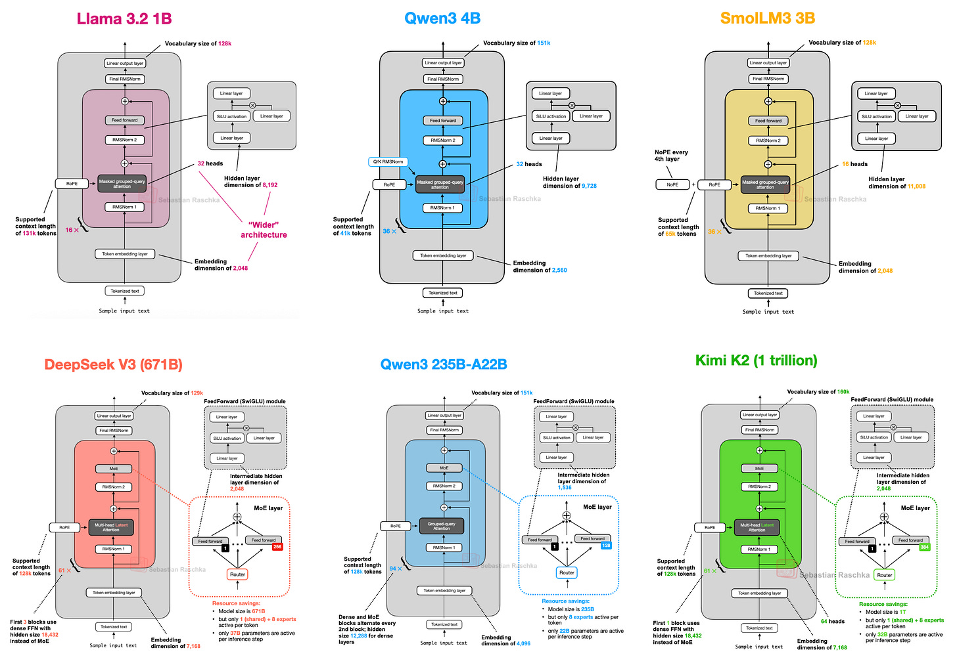
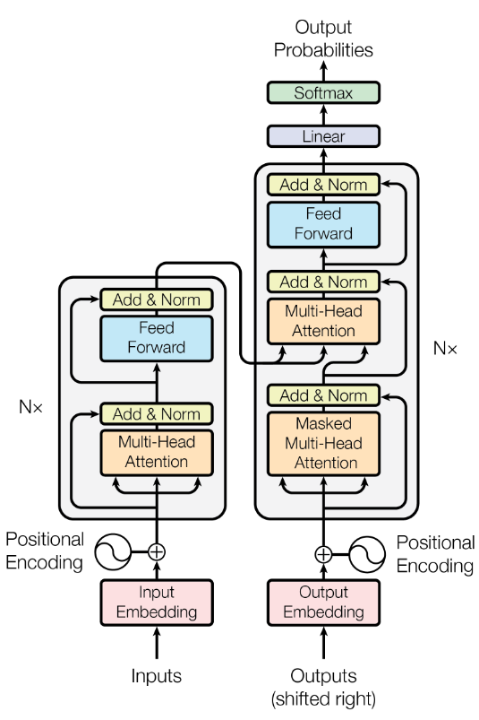
LM Models: Transformer

Slide 15
What is an LM?
Large Language Models (LLMs) are AI systems trained on massive text datasets to understand, generate, and reason with human language.
LM models are built using transformer architecture.
Capabilities:
Context understanding
Text generation (translation, summarization, Q&A, coding)
Examples: GPT-4, Gemini, LLaMA 3, Mistral

Slide 16
LM: Encoder and Decoders
Encoder
Reads & processes input text
Captures meaning and context
Produces embeddings (internal representations)
Example: BERT (understanding tasks)
Decoder
Uses embeddings or previous tokens
Generates output text step by step
Predicts next word until completion
Example: GPT (generation tasks)
Architectures:
Encoder-only → BERT (understanding)
Decoder-only → GPT (generation)
Encoder–Decoder → T5, BART (translation, summarization)

Slide 17
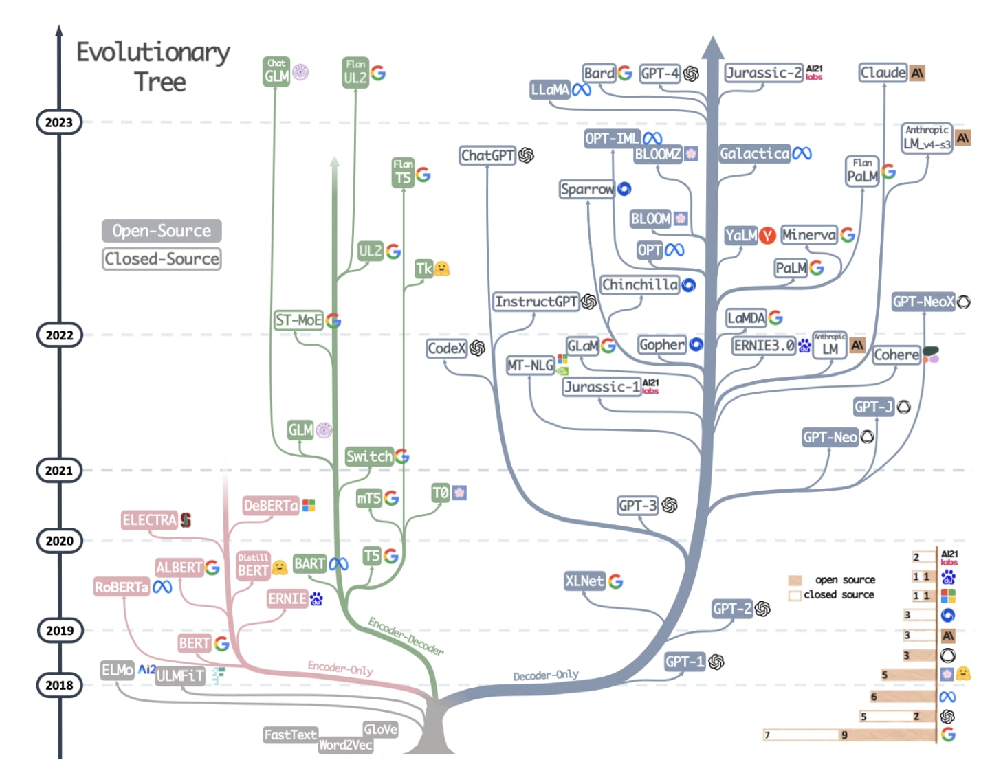
LM evolution

Slide 18
Self-Attention
A mechanism that lets each word look at all other words in a sentence to understand context.
How it works:
Each word is turned into three vectors:
Query (Q) – what am I looking for?
Key (K) – what information do I have?
Value (V) – the actual content.
Attention score = similarity(Q, K).
Weighted sum of V’s = new representation.
Why it matters:
Captures long-range dependencies.
Handles context better than RNNs/CNNs.
Core of Transformers & LLMs.

Slide 19
Flash Attention
An optimized algorithm for computing attention in Transformers.
Doesn’t change the math of self-attention — only the implementation is more efficient.
Reduces memory usage and increases speed without changing model outputs.
Uses tiling and on-chip memory to avoid storing the full attention matrix.
Computes attention in blocks/chunks instead of storing the full attention matrix.
Avoids redundant memory reads/writes → more efficient GPU usage.
Preserves exact attention values (not approximation).
Benefits
2–4× faster training & inference for LLMs.
Handles longer context windows (tens of thousands of tokens).
Enables training of larger models on the same hardware budget.
Applications
Widely used in modern LLMs (e.g., GPT-4, LLaMA 2/3, Mistral).
Critical for efficient fine-tuning and deployment of large models.

Slide 21
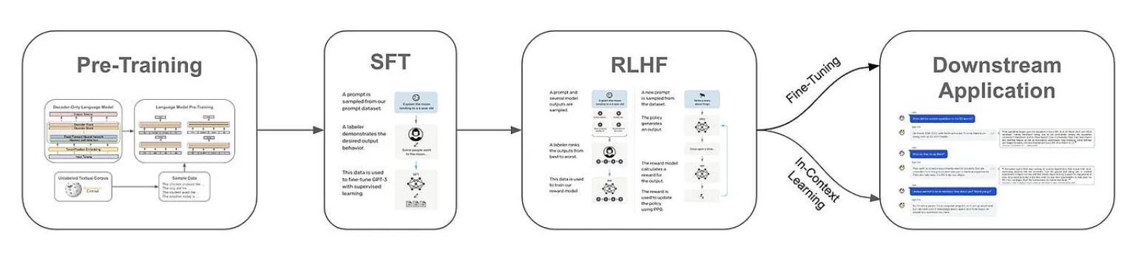
Language Model Training

Slide 22
Supervised Learning in NLP
Machine learning algorithms can be grouped into three primary paradigms: supervised learning, unsupervised learning, and reinforcement learning
In supervised learning, the goal is to learn the mapping function from input to output given a large number of examples in the form of input-output pairs
The input-output pairs are known as training data, and the outputs are specifically known as labels or ground truth
An example of a supervised learning problem related to language is learning to classify email messages as spam or non-spam given thousands of examples in both categories

Slide 23
Unsupervised NLP Learning
Unsupervised learning refers to a set of machine learning methods that aim to find hidden patterns in given input data without any reference output
Unsupervised learning works with large collections of unlabeled data
In NLP, an example of such a task is to identify latent topics in a large collection of textual data without any knowledge of these topics
This is known as topic modeling

Slide 24
Self-Supervised Learning in NLP
SSL aims to learn meaningful representations of input data without using human annotations
It creates auxiliary tasks solely using input data and forces deep networks to learn highly effective latent features by solving these auxiliary tasks
In NLP, various auxiliary tasks have been proposed for SSL, such as next token prediction in GPT, masked token prediction in BERT, text de-noising in BART, contrastive learning, and so on
These models have achieved substantial success in learning language representations

Slide 25
Reinforcement Learning for NLP
Reinforcement Learning is a key paradigm in AI where an agent learns by interacting with an environment.
The agent takes actions, receives feedback in the form of rewards or penalties, and gradually improves its behavior.
Learn a policy (a decision-making strategy) that maximizes cumulative rewards over time.
Core Components
Agent - the learner/decision-maker.
Environment - the system in which the agent acts and receives feedback.
Actions - choices available to the agent at each step.
Rewards - signals of success or failure that guide learning.
Policy - the agent’s rule for selecting actions given its state.
Importance of RL in NLP
Enables models to explore novel responses rather than always imitating training data.
Techniques like RLHF (Reinforcement Learning from Human Feedback) make LLMs (e.g., ChatGPT, Claude) more helpful, safe, and aligned with human expectations.

Slide 26
Contrastive Learning
A representation learning technique that teaches models to distinguish between similar (positive) and dissimilar (negative) data pairs.
Core Idea
Positive pairs - pulled closer together in the embedding space.
Negative pairs - pushed farther apart.
Encourages the model to structure the embedding space based on meaningful similarities and differences.
How does it work?
Frames learning as a discrimination task rather than direct classification.
Helps capture essential features and relationships in data.
Widely used in self-supervised learning, e.g., SimCLR, CLIP.

Slide 27
Contrastive Learning
Supervised
Labels guide training by explicitly defining positive and negative pairs.
The challenge is to use computational resources efficiently while ensuring fast convergence.
Hard pairs/triplets (examples the model struggles with) are especially valuable, as they drive stronger improvements in representation quality.
Unsupervised
Works without labels by leveraging inherent data properties to create pseudo-labels.
Example: SimCLR
Generates positive pairs by applying random transformations (e.g., cropping, color jitter) to the same image.
Negatives are other samples in the batch.
Enables powerful self-supervised learning when labeled data is scarce.

Slide 29
How can we train an LLM?
Training an LLM requires expensive hardware (i.e., many expensive GPUs with a lot of memory) and fancy training techniques (e.g., fully-sharded data parallel training).
These models are usually trained in two phases
Pretraining
Finetuning (multi-steps)
Where the former phase is (much) more expensive
Given that high-quality pretrained LLMs are readily available online, most AI practitioners can simply download a pretrained model and focus upon adapting this model (via finetuning) to their desired task.

Slide 30
Training LMs
Massive Data Collection
Diverse sources: books, web, code, scientific papers, speech, images.
Multilingual, multi-domain, cleaned & deduplicated.
Tokenization & Representation
Break data into tokens (words, subwords, pixels, audio chunks).
Convert into embeddings for model input.
Pretraining (Core Stage)
Train on self-supervised objectives:
Next-token prediction (decoders).
Masked-token prediction (encoders).
Multimodal tasks (image–text pairs, speech–text).
Requires huge computation resources (GPUs/TPUs, distributed clusters).

Slide 31
Training LMs
Adaptation / Fine-tuning
General → Domain-specific (e.g., healthcare, law, code).
Parameter-efficient tuning (LoRA, adapters, QLoRA).
Alignment
Human feedback (RLHF, DPO, safety filters).
Bias, fairness, factuality, safety checks.
Deployment & Scaling
Model compression (quantization, pruning).
Efficient inference (speculative decoding, FlashAttention).
APIs, cloud, or edge deployment.

Slide 32
Encoder Training
Learn deep representations of input text.
Use Masked Language Modeling (MLM) training
Hide some words in the sentence.
Train model to predict missing words from context.
Example: “The cat sat on the [MASK].” → “mat”
Key Models: BERT, RoBERTa
Use Cases:
Text classification
Named Entity Recognition (NER)
Sentiment analysis

Slide 33
Decoder Training
Learn to generate text step by step.
Uses Causal / Autoregressive Language Modeling
Predict next word given all previous words.
Example: “The cat sat on the” → “mat”
Key Models: GPT, LLaMA
Use Cases:
Text generation
Machine translation
Summarization, Q&A

Slide 34
Foundation LLM
A large-scale AI model trained on vast, diverse datasets (text, images, code, etc.) that serves as a general-purpose base for a wide range of downstream tasks.
Pretrained at scale: billions of parameters, trillions of tokens.
Versatile: can be adapted to many domains (translation, reasoning, summarization, coding).
Multi-modal potential: can handle text, images, audio, or combinations.
Reusable: forms the foundation for fine-tuning and domain adaptation.
Examples
Text: GPT-4, LLaMA 3, Claude
Vision: CLIP, DINOv2
Multimodal: Gemini, GPT-4o
Why Important?
Reduces the need to train new models from scratch.
Democratizes access to advanced AI by enabling fine-tuning for specific tasks.
Drives progress across industries (healthcare, finance, education, etc.).

Slide 35
Task specific LLM
Specialized LLMs created by fine-tuning a foundation model on task-focused data.
Adapt the model’s general abilities to excel at a specific application.
The are built using foundation LLMs
Start with Foundation Model (e.g., GPT-4, LLaMA 3).
Fine-tune / Align on curated datasets.
Supervised fine-tuning (SFT).
Parameter-efficient tuning (LoRA, Adapters, QLoRA).
RLHF / instruction tuning.
Deploy as a domain-optimized task model.
Examples
Med-PaLM - healthcare / clinical question answering.
LawGPT - legal document drafting.
FinBERT - financial sentiment analysis.
Benefits
Higher accuracy in target tasks.
Efficiency: avoids retraining from scratch.
Reliability: aligns outputs with domain expectations.

Slide 36
Instruction fine-tuning
A technique to adapt foundation models by training them on datasets of instructions and responses.
Makes models follow human instructions reliably.
Improves usability for non-technical users.
Reduces irrelevant or hallucinated outputs.
Better Alignment
Aligns model behavior with human intent.
Produces safer, more task-relevant answers.
Efficiency for Smaller Models
Even “small” LLMs (<2B parameters) can compete with GPT-3.5 or LLaMA-2 when fine-tuned on domain data.
Example: FLAN-T5 Large excelled at meeting summarization despite being much smaller
Foundation for Assistants
Forms the backbone of conversational AI (ChatGPT-style systems).
Enables cost-effective domain-specific deployments.

Slide 37
Preference Fine-Tuning
A process to adapt LLMs so their outputs match human preferences (helpfulness, safety, tone).
Moves beyond raw accuracy and focuses on alignment with user expectations.
How to fine tune for preference
Human Feedback: Collect comparisons of model responses (“preferred”vs “not preferred”).
Reward Model: Train a smaller model to predict these preferences.
Fine-Tuning: Update the base LLM with methods such as:
RLHF – Reinforcement Learning from Human Feedback.
DPO – Direct Preference Optimization.
LiPO & others – advanced ranking-based methods

Slide 38
LLM Alignment: In general
Traditional Alignment Criteria
Helpfulness
Harmlessness
Instruction-following ability
Other safety & usability goals
Two-Stage Fine-Tuning Process
Supervised Fine-Tuning (SFT):
Train the model on curated, high-quality reference responses.
Uses a next-token prediction objective.
Teaches the LLM to mimic the style, tone, and format of desired outputs.
Reinforcement Learning from Human Feedback (RLHF):
Collect human feedback on the model’s responses.
Train a reward model that scores outputs.
Fine-tune the LLM so it optimizes for outputs humans prefer.
Key Difference:
SFT - Mimic good examples.
RLHF - Learn from human preferences.

Slide 39
Fine Tuning: Issues
The size of the model does not change during finetuning!
As a result, finetuning an LLM — though cheaper than pretraining — is not easy.
We still need training techniques and hardware than can handle such a model.
Plus, and every finetuning run creates an entirely separate “copy” of the LLM that we must store, maintain, and deploy — this can quickly become both complicated and expensive!

Slide 40
So, how to fine tune?
Use Parameter Efficient Fine Tuning (PEFT)
Instead of training the full model end-to-end, parameter-efficient finetuning leaves pretrained model weights fixed and only adapts a small number of task-specific parameters during finetuning
PEFT drastically reduces memory overhead, simplifies the storage/deployment process, and make it possible to finetune LLMs with more accessible hardware.
Later we will discuss: Prefix tuning, adaptive layers, LoRA, etc.

Slide 41
Topics in modern NLP: using LLM
Decoding and Interpreting LLMs: decoding LLMs is one of the most exciting topics in NLP right now.
Traditionally, decoding was treated as just “choosing the next word,” but modern research shows how we decode directly affects reasoning, truthfulness, and creativity of large language models.
Why decoding is important?
Training gives the model knowledge, but decoding decides how that knowledge is expressed.
A poor decoding method can make even a powerful LLM look dumb (nonsensical, repetitive, hallucinating).
Decoding is where we balance creativity vs. accuracy, diversity vs. reliability.

Slide 42
Topics in modern NLP: Decoding
Greedy search picks the most likely next token
Fast, but repetitive.
Beam search explores multiple candidate sequences
Better fluency but can still lack diversity.
Sampling methods:
Top-k sampling (choose among the top k tokens).
Nucleus sampling (top-p)
Sample from tokens whose cumulative probability ≥ p.
These are useful but limited when models are very large and tasks are complex.
Advanced Decoding Strategies
Reasoning-Aware Decoding:
Chain-of-Thought (generate reasoning steps)
Self-Consistency (vote across multiple reasoning paths)
Tree/Graph-of-Thoughts (explore structured reasoning)
Constrained/Responsible Decoding:
Disallow unsafe outputs
Require citations or factual grounding

Slide 43
Topics in modern NLP: Decoding
Multimodal Decoding
Decoding is no longer limited to plain text.
Models can output text + images + code + actions.
Examples:
Describe an image and then answer questions about it.
Generate code that runs, not just text snippets.
Control robots or IoT devices by decoding into action sequences.
Programmatic Decoding
Instead of free-form text, models generate structured programs (Python, SQL, JSON).
These outputs can be executed to get reliable results.
Example: “What’s the average temperature last week?” → LLM decodes into SQL → runs on database → returns exact value.
This moves decoding closer to symbolic reasoning + factual precision.
Efficiency-Oriented Decoding
Speculative decoding: Model drafts multiple tokens in parallel, then verifies them quickly. Speeds up inference by 2–4x.
Early exit decoding: Stop computations once the model is “confident enough,” reducing latency.
Parallel decoding: Break away from left-to-right bottleneck, predict chunks of tokens at once.
Goal: Make LLM decoding fast, cheap, and deployable on edge devices.

Slide 44
Topics in modern NLP: Decoding
Controllable Decoding
Adding constraints so the model respects logic, structure, or rules.
Examples:
Generating SQL queries that are always valid.
Forcing step-by-step reasoning chains.
Used in code generation, math solvers, legal/medical NLP.
Alignment-Aware Decoding
Models are fine-tuned with human feedback (RLHF, DPO), but decoding still matters.
New strategies (e.g., constrained beam search, value-guided decoding) ensure outputs align with human intent, not just probability.
Reasoning-Oriented Decoding
Instead of producing answers directly, decoding can enforce deliberation.
Chain-of-thought (CoT) decoding: model generates intermediate reasoning steps before the final answer.
Tree-of-thoughts and graph-of-thoughts: explore multiple reasoning paths, then pick the best.

Slide 45
Topics in modern NLP: Decoding
Energy- and Efficiency-Aware Decoding
For deployment on phones/IoT, decoding must be lightweight.
Research explores speculative decoding (draft + verify tokens in parallel) and early exit decoding (stop generating when confident).
Dramatically reduces cost without sacrificing quality.
Safe & Trustworthy Decoding
Guardrails at decoding time prevent toxic or biased content.
Example: blocking unsafe tokens, or re-ranking outputs by factuality.
Frontier: “factual decoding” guided by retrieval from trusted sources.

Slide 46
Topics in modern NLP: Reasoning
Deep Semantic Reasoning: Beyond Surface-Level Understanding
Equips models with ability to reason about language in a more human-like manner.
Emphasizes capturing implicit meaning, causal relationships, common-sense knowledge, and abstract concepts.
The central challenges include handling sarcasm, metaphor, figurative expressions, and intricate logical structures embedded in text.

Slide 47
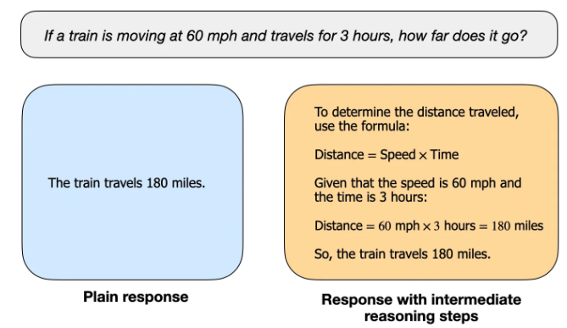
Topics in modern NLP: Reasoning
Factual question-answering like "What is the capital of France?" does not require reasoning.
However, question like "If a train is moving at 60 mph and travels for 3 hours, how far does it go?" requires some simple reasoning.
For instance, it requires recognizing the relationship between distance, speed, and time before arriving at the answer.

Slide 48
Topics in modern NLP: Reasoning
Reasoning models are designed to be good at complex tasks such as solving puzzles, advanced math problems, and challenging coding tasks.
However, they are not necessary for simpler tasks like summarization, translation, or knowledge-based question answering.
Using reasoning models for everything can be inefficient and expensive.
Reasoning models are typically more expensive, more verbose, and sometimes more prone to errors due to "overthinking."

Slide 49
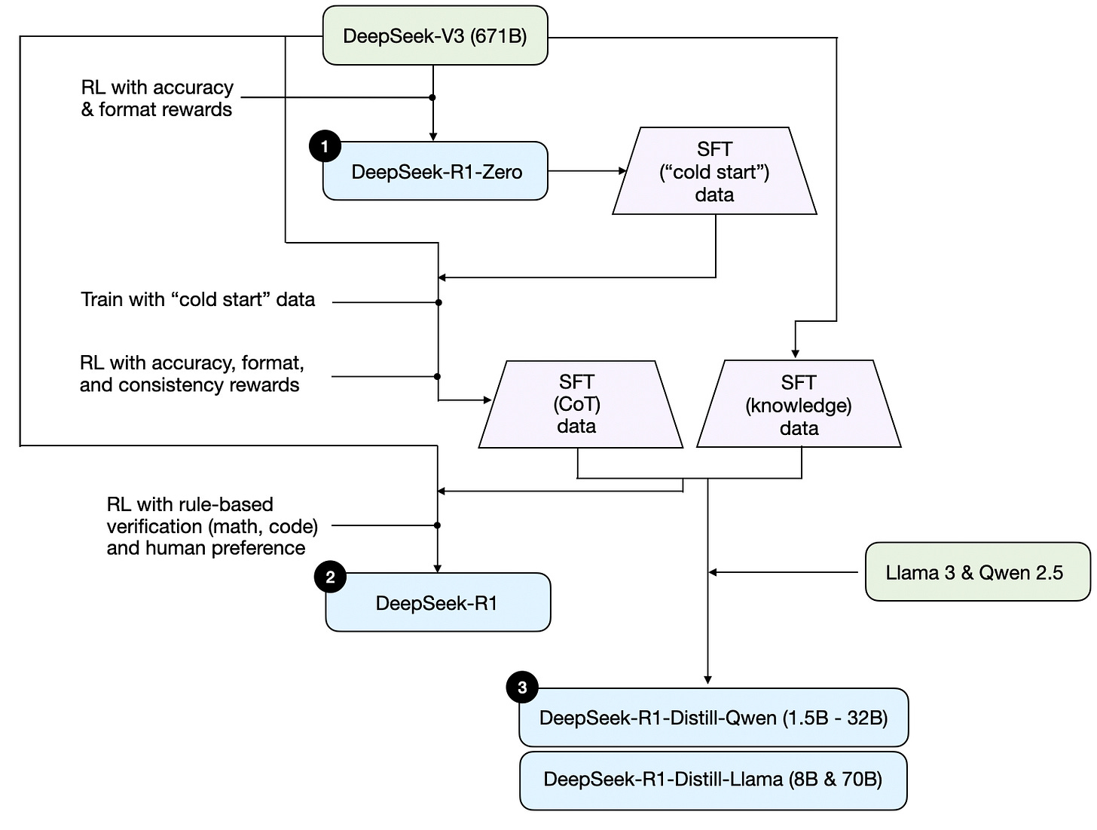
DeepSeek training for Reasoning

Slide 50
Topics in modern NLP: Modality
Multimodal LLM: an AI model that goes beyond text, combining language + vision + audio + more, making interactions more natural and powerful.
"Modality" refers to a type of data
Text (like in traditional LLMs), sound, images, videos, and more.
Why It Matters
Closer to human-like understanding (we don’t use just text, we use vision, hearing, context).
Enables richer applications:
AI tutors that see and hear students.
Healthcare assistants analyzing medical images + patient history.
Robots understanding both instructions (text) and their environment (vision/audio).

Slide 51
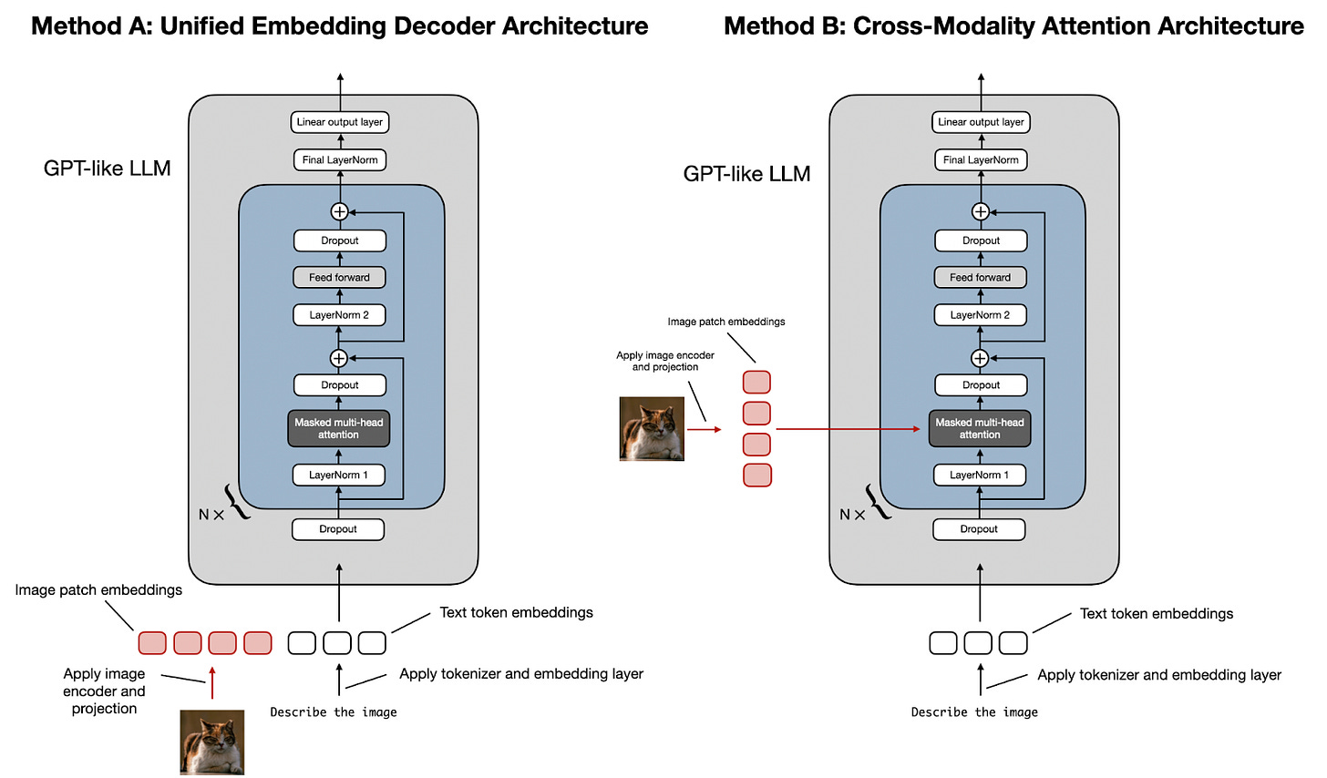
How to train a multimodal Model?

